Slide 1
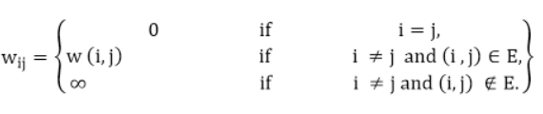
All Pair shortest Path – Dynamic Programming Approach
All Pairs Shortest Path Algorithm is also known as the Floyd-Warshall algorithm. And this is an optimization problem that can be solved using dynamic programming.
Problem:
“Let G = <V, E> be a directed graph, where V is a set of vertices and E is a set of edges with nonnegative length. Find the shortest path between each pair of nodes.”
The input is a n x n matrix Cost matrix representing the edge weights of an n-vertex directed graph G = (V, E). That is, Cost = (w_{ij}), where

Slide 2
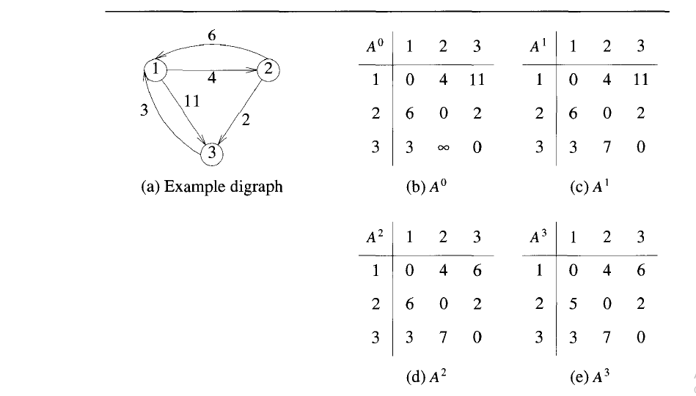
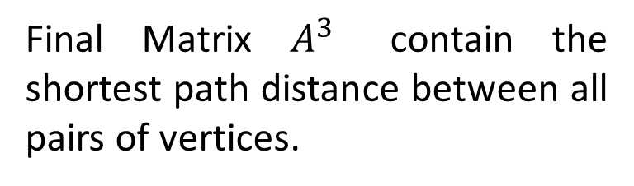
All Pair shortest Path – Floyd Warshall Example
Final Matrix $A^{3}$ contain the shortest path distance between all pairs of vertices.

Slide 3
All Pair shortest Path – Floyd Warshall Formula
Principle of optimality :
If k is the node on the shortest path from i to j, then the path from i to k and k to j, must also be shortest.
While considering k^{th} vertex as intermediate vertex, there are two possibilities :
If k is not part of shortest path from i to j, we keep the distance A[i, j] as it is.
If k is part of shortest path from i to j, update distance A[i, j] as A[i, k] + A[k, j].
Optimal sub structure of the problem is given as :
Where Ak = Distance matrix after kth iteration
A^{k} [i, j] = min{ (A^{k – 1} [i, j]), (A^{k – 1} [i, k] + A^{k – 1} [k, j]) }

Slide 4
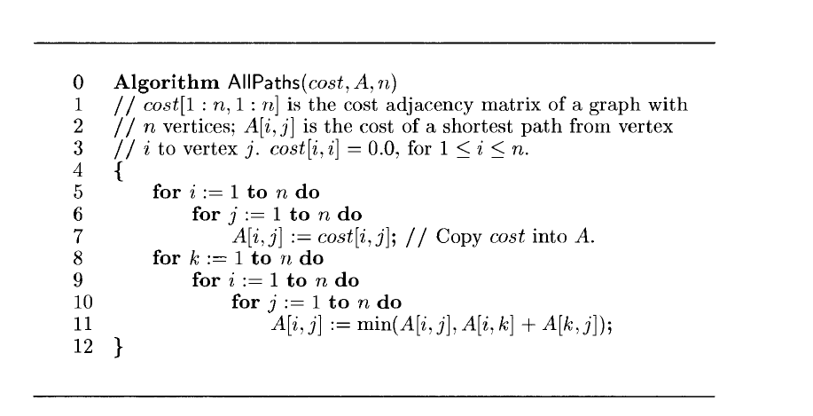
All Pair shortest Path – Floyd Warshall Algorithm
Time Complexity :
This algorithm uses three nested for loops, each running from 1 to n.

Slide 5
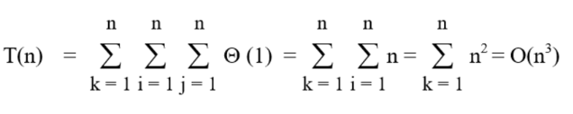
Time Complexity – Floyd Warshall Algorithm
This algorithm uses three nested for loops, each running from 1 to n.
The innermost loop has only one statement. The complexity of that statement is O(1).
The running time of the algorithm is computed as :

Slide 6
MCQs
Which of the following is/are property/properties of a dynamic programming problem?
a) Optimal substructure b) Overlapping sub-problems c) Greedy approach d) Both optimal substructure and overlapping sub-problems

Slide 7
MCQs
If an optimal solution can be created for a problem by constructing optimal solutions for its sub-problems, the problem possesses ____________ property.
a) Overlapping sub-problems b) Optimal substructure c) Memoization d) Greedy

Slide 8
MCQs
If a problem can be broken into sub-problems which are reused several times, the problem possesses ____________ property.
a) Overlapping sub-problems b) Optimal substructure c) Memoization d) Greedy

Slide 9
MCQs
If a problem can be solved by combining optimal solutions to non-overlapping problems, the strategy is called _____________
a) Dynamic programming b) Greedy c) Divide and conquer d) Recursion

Slide 10
MCQs
Explanation:
In divide and conquer, the problem is divided into smaller non-overlapping sub-problems and an optimal solution for each of the sub-problems is found. The optimal solutions are then combined to get a global optimal solution. For example, merge-sort uses divide and conquer strategy.

